Slide 1
Designing mechanical parts in Inkscape and FreeCAD
Emery Premeaux
Tokyo HackerSpace

Slide 2
Downloads
Download and install the following tools if you have not already done so
  FeeCAD: www.freecadweb.org
  Inkscape: www.inkscape.org
  Sample files: https://github.com/DIYsciBorg/FreeCAD_Electro-mechanical

Slide 3
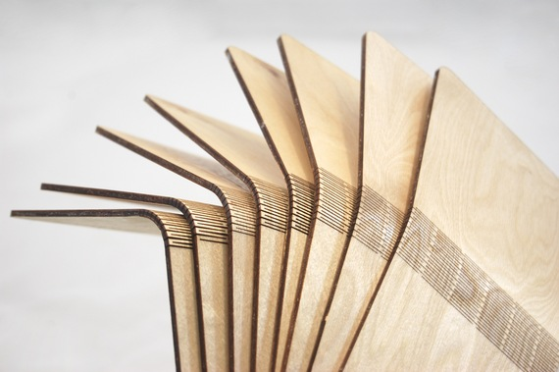
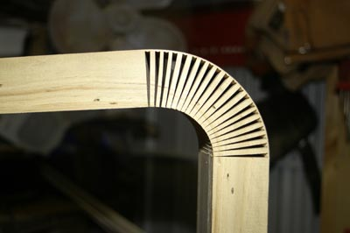
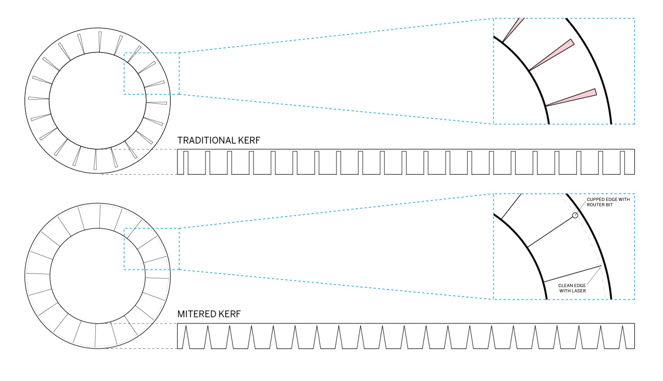

Slide 4
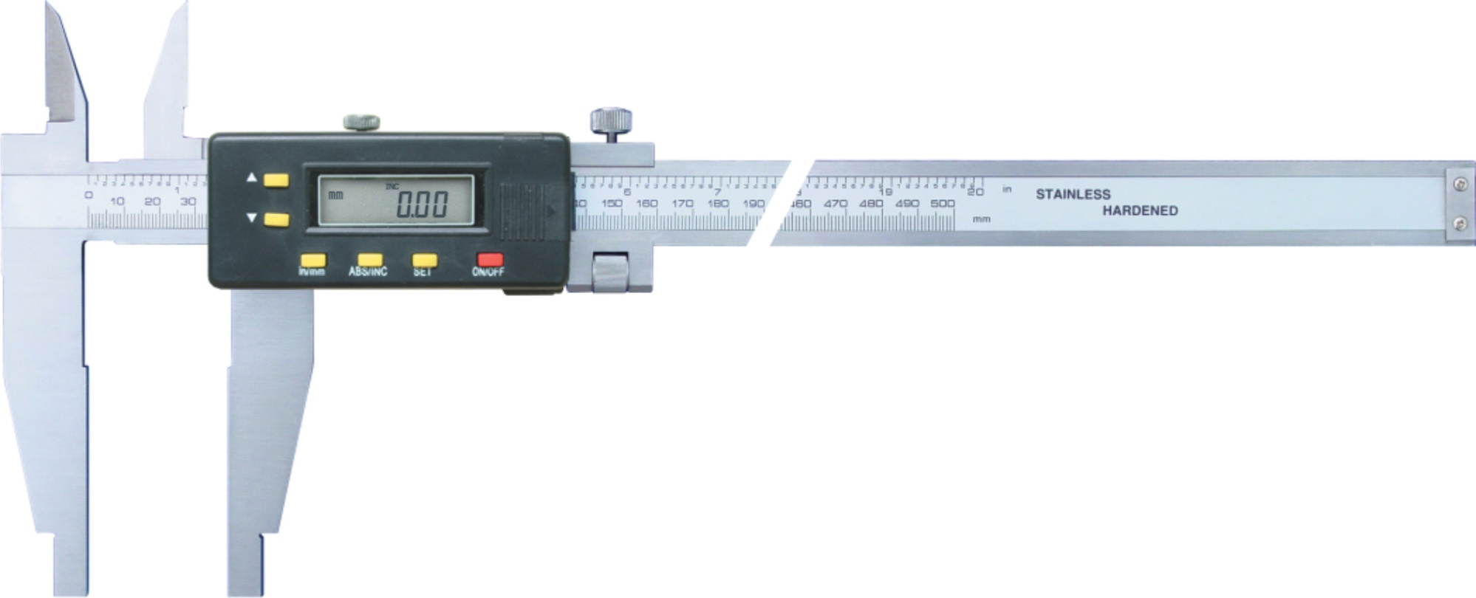
Calipers are your best friend!

Slide 5
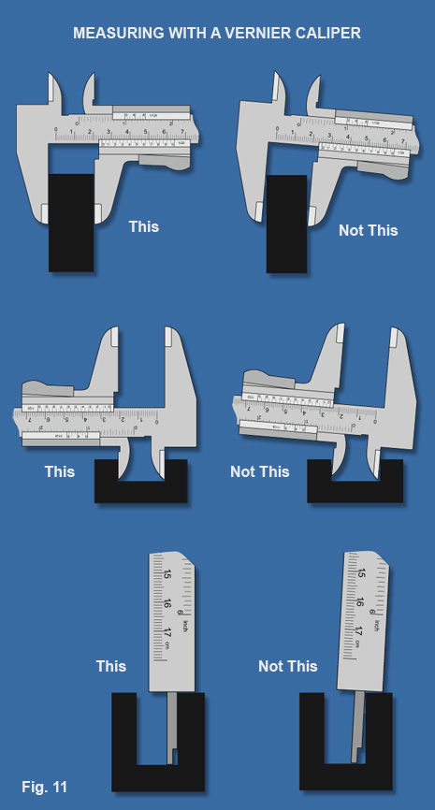

Slide 6
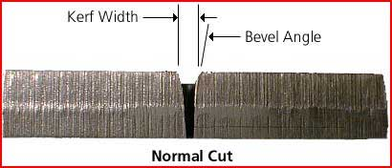
Part 1: Inkscape and Lasercutting
What is kerf?
  The loss of material caused by the cutting action. Usually dictated by the width of the cutting tool, as well as an additional ‘throw out’ which results in a bevel.

Slide 7
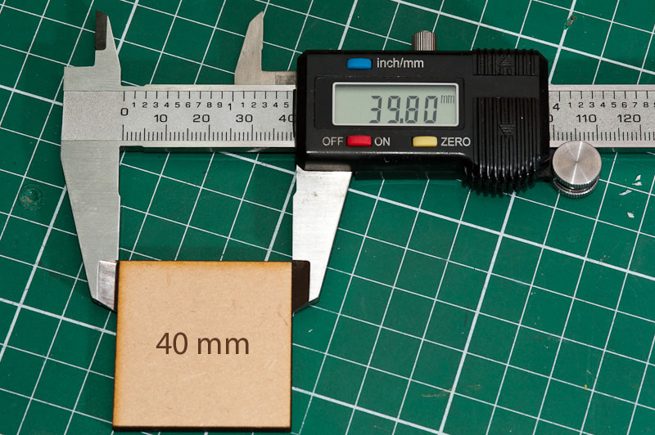

Slide 8
We must account for Kerf!
Materials | Thickness | Average Kerf
Acrylic | 1mm-3mm | 0.18mm
Acrylic | 5mm-8mm | 0.21mm
Acrylic | 10mm-15mm | 0.3mm
Acrylic | 20mm | 0.32mm
HIPS, PETG, Styrene, | 1mm-3mm | 0.45mm
Birch plywood | 0.8mm | 0.08mm
Birch plywood | 1.5mm | 0.16mm
Birch plywood | 3mm | 0.2mm
Birch plywood | 6mm | 0.22mm
Birch plywood | 12mm | 0.3mm
MDF | 3mm | 0.16mm
MDF | 6mm | 0.2mm
MDF | 12mm | 0.28mm
Veneered MDF | 6mm | 0.17mm
Greyboard | 1200microns | 0.08mm
Greyboard | 2400microns | 0.12mm
Paper | 90 – 350 gsm | 0.08mm
    From: http://www.cutlasercut.com/resources/tips-and-advice/what-is-laser-kerf

Slide 9
Importing is a PITA!
Most shops use AI or Corel. FabCafe uses Corel. Importing inkscape files has some special challenges.
The Corel can read SVG.
BUT scaled text get’s wonky.
You MUST use the “Convert to Text” option or text will not be visible. Which is weird. I thought it WAS text.

Slide 10
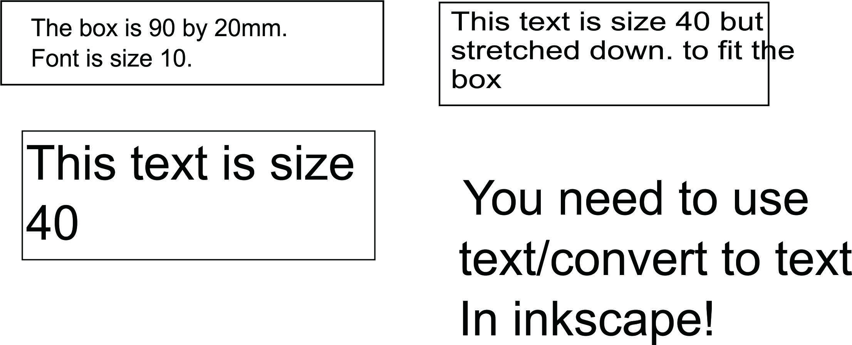
A sample import
The lesson here is: DON’T scale text by dragging the box size around. Use the CORRECT font size for the job.

Slide 11
Cut Vs Etch
The cutter can CUT and ETCH.
IF we want to do both, it is actually TWO separate operations. (and so on for each level of etching).
We need to help them out with a guide.
Use color. Black lines are cut lines.
Use Primary, NAMED colors for etching percentage (Red, Green, Blue, etc)

Slide 12
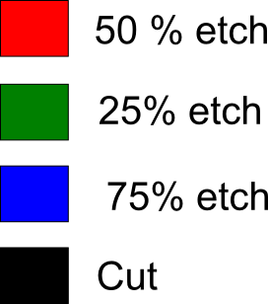
The color picker
Put this guide OFF PAGE for the shop to pick up the color and quickly assign laser power.
When you are laying out your design, be sure to use ONLY these colors.

Slide 13

The importance of scale
Again, importing can lead to all sorts of mishaps. Don’t waste your laser time (and the shop’s time) trying to fix all this stuff.
Place a scale marker (again, OFF PAGE) for the shop to reference. If your import looks strange, then can draw their own scale and resize your whole file to fit.

Slide 14
DO IT! (Inkscape)
Set page size to 180 x 320 MM (or another size of material)
Set the default units to MM. Pixels is USELESS for us.
Place a scale marker
Place a cut and etch picker
Place additional material notes off page (thickness, color, etc. This will assure the shop wont make mistakes by cutting the wrong stuff)
Draw out a pocket ruler that can measure 10mm

Slide 15
Going 3D!
Most 3d packages have two major modes
  Primitive builder
  Sketch and Solver

Slide 16
Primitives aren’t so primitive
Primitives are simple 3D shapes (ball, cube, cone).
Using just these shapes and some math (merge, subtract, cut) you can make complex shapes.

Slide 17
Draw a sketch. Then solve it!
The sketcher/solver functions similar to Inkscape. You draw an object on a 2D plane.
The solver automatically checks your math.
It solves for “constraints.” These are locked points or dimensions.
When a sketch is fully constrained, it can then be extruded to a 3D object.

Slide 18
A note about navigation styles
When using primitives in the full scene 3D view, I prefer to use Inventor Navigation
When working with sketches, you REALLY need to be in CAD navigation mode. Any other mode will really mess your shit up! (attempting to draw something moves your page around!)
You can only switch modes in the 3D scene. So if you get stuck, CLOSE the sketch (task tab), change modes, then reopen the sketch.

Slide 19
Working with Primitives
Start a new project
Use the Part workbench
Create a solid box (default values are fine)
Create a cylinder
Select the box, then CTRL select the Cylinder
Make a cut of the two
Use UNDO to go back and try the other math operations.
(Select and Spacebar will show the part again)

Slide 20
What Parametric means
Cut a cylinder or cone from the center of the cube
(hint: Placement/position moves items around in 3D space)
Expand the Cut I the project tree
Change the radius of the Cylinder

Slide 21
Sketchin and solvin. Solvin and sketchin!
Switch to the part design workbench
Create a new sketch in the XY-Plane
Use the view snaps to get a grip on where you are.
I was going to write a tutorial on drawing with the sketcher, but its better to just follow the Hack-a-day tutorial ;)

Slide 22
Sketcher hints
Expand the sketcher related tool bars
“Create a coincident constraint…” means to snap these two selected points together.
The “thin” tools are for drawing
The “fat” tools are for locking in constraints
“Trim” cuts things out.
Right clicking will release a tool type.
Check the solver messages!

Slide 23
Hack-a-day tutorial
A great (but missing some critical details) tutorial on HAD for FreeCAD using the sketch/ solver (two parts)
http://hackaday.com/2014/02/05/3d-printering-making-a-thing-in-freecad-part-i/

Slide 24
If we have time/homework
Open some of the example files
  My freeCAD files include some mechanical parts. Get a good look at them. These were ALL built with primitives.
  There is also the rack mount PSU project called Apollo that Chris, Akiba and I were working on
Add to the repository of parts!
Draw up a part from the THS inventory, or something you would like to use

